Slide 1
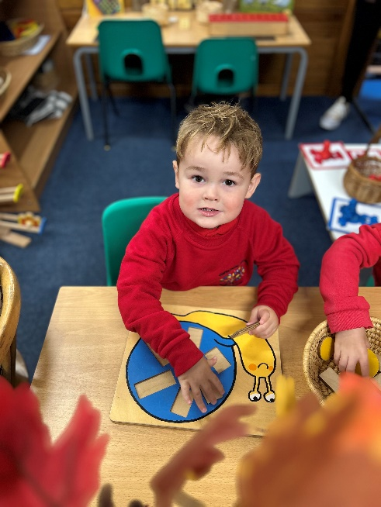
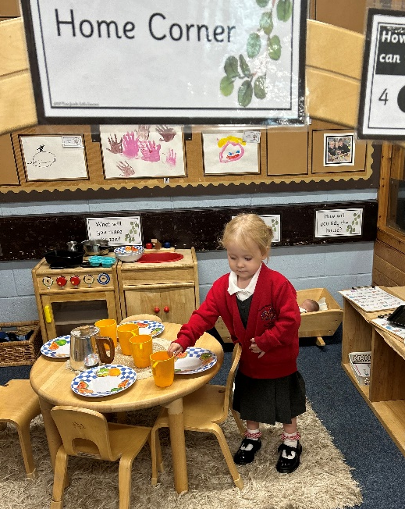
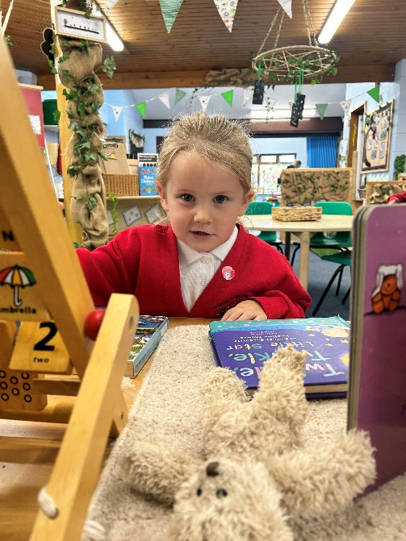
Guidance to your child’s learning and development in the early years foundation stage
Class 1 Willow & Oak
Stay & Learn
Prime Areas Stay and Learn

Slide 2
Early Years Curriculum
7 areas of learning and
development
PRIME AREAS
Communication and Language
Personal, Social and Emotional Development (PSED)
Physical Development
SPECIFIC AREAS
Literacy
Mathematics
Understanding the World
Expressive Arts and Design

Slide 3
Early Years Curriculum
Characteristics of Effective
Learning
3 Characteristics of effective teaching and learning are:
Playing and exploring- children investigate and experience things and ‘have a go’
Active learning- children concentrate and keep on trying if they encounter difficulties, and enjoy achievements
Creating and thinking critically- children have and develop their own ideas, make links between ideas, and develop strategies for doing things

Slide 4
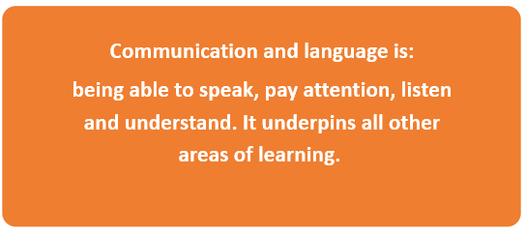
* Developing pretend play & language * Listen to simple stories and use pictures to develop understanding * Understand simple questions- who, what, where
Prime Area
Communication and Language

Slide 5
Prime Area
Communication and Language
Ideas to support at home
Listen to lots of stories, songs and rhymes- create reading dens or special places to share your child’s favourite book
Encourage your child to join in with repetitive phrases in familiar stories- explore different voices
Develop questioning in your child’s daily routine- What will Mummy use to cut the bread?
Use lots of positional language when playing- put teddy under/on/behind the chair- where is teddy?
Give your child simple instructions to complete- hang up your coat, put your shoes in the cupboard please
Recall experiences- yesterday we went to the park- what did we see? Who went down the slide?
Encourage your child to copy new words in their play- the elephant was enormous- can you say enormous?

Slide 6
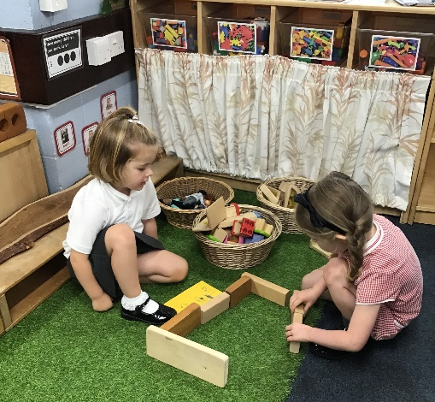
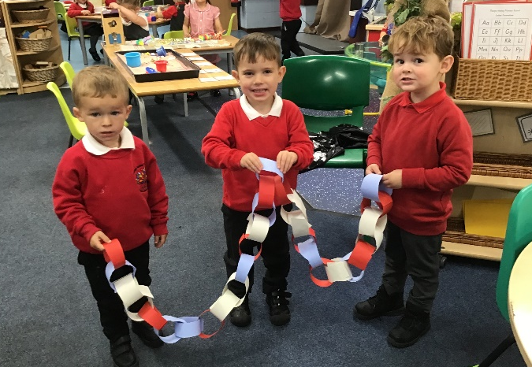
* Making Friendships * Taking turns in play * Talking about & managing own emotions * Learn to use the toilet independently
Prime Area
PSED
Personal, Social & Emotional Development

Slide 7
Prime Area
PSED
Personal, Social & Emotional Development
Ideas to support at home
Give opportunities for your child to make their own choices in their play, adult develop children’s play ideas
Develop turn taking in play or within daily routines- my turn your turn- adult to give lots of praise
Build times during the day when your child needs to wait for your attention
Discuss feelings and emotions- encourage your child to talk about how they feel. Make feelings faces in the mirror- discuss times when you feel sad, happy angry etc..
Talk about how behaviour/words can upset others

Slide 8
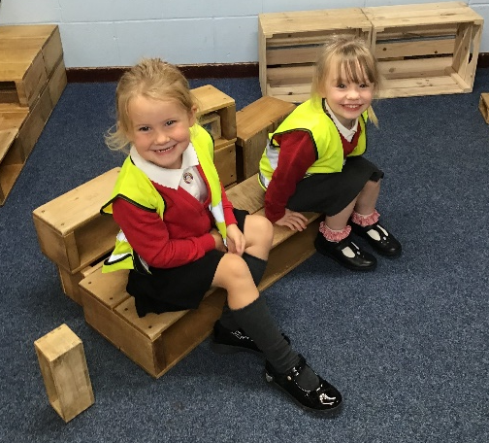
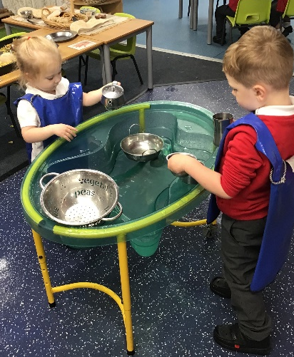
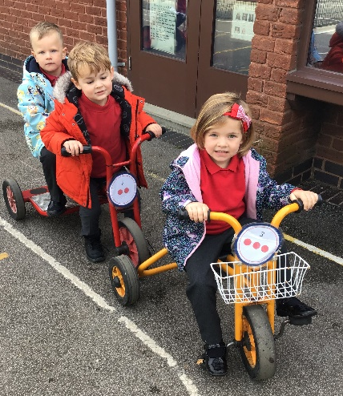
* Use large & small motor movements * Explore different materials & tools * Develop manipulation & control- tearing paper, mark making, playdough * Dressing & undressing- buttons/zips
Prime Area
Physical Development

Slide 9
Prime Area
Physical Development
Ideas to support at home
Make an obstacle course to encourage your child to move in different ways- climbing up and off objects- balancing, jumping, skipping and stopping on command
Encourage your child to push along on scooter or peddle bikes/ride balance bikes around obstacles
Use a variety of large and small motor movements –
Sweeping up
Washing windows- using anticlockwise movements
Flappers (tea towels) to music
Tearing paper/envelopes- to support bilateral movements
Pincer grip- picking up small objects thumb and finger/tweezers
Explore lots of early mark making- patterns in shaving foam, chalk outdoors, water and big brushes/rollers/playdough

Slide 10
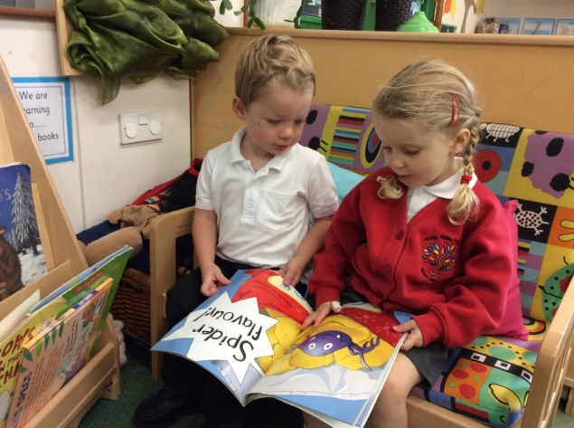
Prime Area
Early Reading
Ideas to support at home
Provide enticing areas for sharing books, sharing a wide range of books matching your child’s interests
Build small world play themed around child’s favourite stories
Link activities to stories you have read- when going to the park splash in the puddles and squelch in the mud ‘We’re going on a Bear hunt’
Point out print in the environment and talk about what is means- shop names, road signs, door numbers etc..
Explore character voices when sharing stories or add action songs to build excitement

