Slide 1
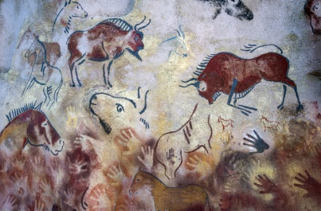
Through the Ages!
History | In History, we will be travelling back in time to the Stone Age. We will be using clues and artefacts to help us understand how early man survived. We will also be developing our understanding of chronology using timelines.
Science | Over the course of the ‘Through the Ages’ topic, we will be learning about ‘Rocks & Light’. There will be lots of exciting experiments including creating our own fossils and a shadow box!
DT | In DT, we will be designing, making and evaluating Stone Age inspired drawstring bags.
Art | In Art, we will be creating our own cave drawings using various media including charcoal and pastels.
Computing | In Computing, we will be learning about technologies.
PE | In Autumn 1, we will be focusing on developing skills in invasion games and gymnastics. In Autumn 2, we will improve our skills in invasion games and net and wall games.
Music | We will be developing our understanding of pitch, pulse and rhythm in our singing lessons this term.
Spanish | In Spanish in year 3, we will be learning basic greetings, how to ask people how they are and classroom instructions.
RE | We will be learning about Christianity and develop an understanding of Jesus’ parables.
PSHCE | In PSHCE, we will be looking at how we make ourselves and others happy. We will also be looking at why having a group of friends is important and what makes a healthy friendship.
Our Topic
This term’s topic, Through the Ages, will allow the children to explore the Stone Age, Iron Age and Bronze Age. We will be kicking off this term’s learning with a Stone Age themed day where the children will be taking part in various workshops including cave drawings, Stonehenge silhouette art, salt dough jewellery and we even have a special visitor coming into school.
We will be reading the story The Wild Way Home as our class novel during this term.
PE
We ask that children have their full PE kit in school at all times and only take them home at the weekend and during holidays.
Homework
In Year 3, we have high expectations with homework and expect it to be handed in on time and to a high standard. Children in Year 3 will be expected to:
• Regularly read at home. At least three times a week. Teachers will check the children’s home school diary at the end of each week.
• Learn their weekly spellings to be given out on a Friday to be completed for the following Friday.
• Complete maths homework every other week set by the maths teacher. This will also be handed out/collected in on a Friday.
Project homework about the Stone Age (see opposite). One page to be handed in every other Friday (alternating with maths homework).
Thank you for your continued support. The Year 3 Team
Stone Age Homework Project
Children have an optional creative homework project this term which can be handed in at any time before Friday 6th December 2024. The homework can be linked to our topic, through the ages – the Stone Age, Iron Age or the Bronze Age. The project can be completed alone or with adult or sibling support and should be of a good quality.
Ideas for projects include creating some cave art, making model of a round house or settlement, a timeline of this period of history, baking bread to a Stone Age bread or making a stone age outfit.

