Slide 1
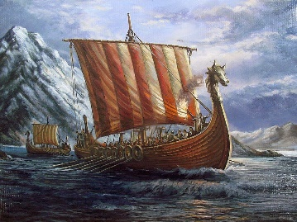
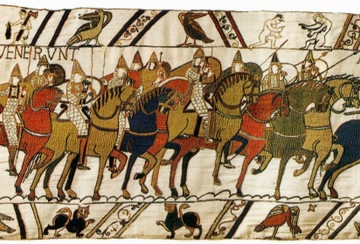
Year 4 Autumn Term
Invaders and Settlers
Below is an overview of what we will be learning this term.
Science | Children will be looking at plants and sound. Children will learn about the features of plants and how a flower functions. With sound, children will understand how humans hear and the different parts of the ear and their purposes.
History | Children will look at the history of our islands from the Celts to the Normans, taking in the Romans, Vikings and Anglo Saxons on the way. We will be having a Viking Day which will include a visit from POPS Outdoor Adventure.
Geography | In geography, we will be looking at the human and physical geography of the British Isles.
Art | Children will be looking at creating their own interpretation of the Bayeux Tapestry. Children will be looking at famous artists and drawing upon their ideas and different media to plan and create their own.
ICT | Children will be looking at modern technology and how websites are created. We will also be learning about how to keep safe online.
RE | In RE, children will be focusing on Hinduism and Christianity. In Hinduism, we will be looking at the journey of life and the different Gods. In Christianity, we will be looking at the Christmas story.
PE | In PE, we are focusing on hockey as part of our invasion games and also trying out different Paralympic sports.
PSHE | In PSHE, we will be focusing on rules and respect. Children are to understand how rules impact their daily life in and out of school and how respect is shown in the wider community.
Music | In Music, children will be focusing on pitch, tempo and rhythm to create their own interpretation of a song. Children will also be focusing on a different musician each month to enhance their cultural awareness of music.
Spanish | Children will be recapping classroom instructions and learning about animals and parts of the body.
Our Topic
During the Autumn term, our first topic will be a whole-school creativity focus on Paris Paralympics. This will then be followed by our Year 4 topic of ‘Invaders and Settlers’ which will focus on learning about the history of our islands from 550BCE until 1066, covering a whistle stop tour of the Celts, the Romans, Anglo Saxons, Vikings and Normans. We will be reading ‘Riddle of the Runes – A Viking Mystery’ by Janina Ramirez.
Homework
In Year 4, we have high expectations with homework and expect it to be handed in on time and to a high standard. Children will be expected to:
Regular reading at home (at least three times a week). Teachers will regularly check reading records and value an adult’s comment in there.
Learn their weekly spellings to be given out on a Friday to be completed for the following Friday.
Complete a weekly maths or English activity, linked to something we have recently covered in class. This will also be set on a Friday via Doodle learning.
In addition to this, children can complete a piece of creative homework per term (see to the right) if they wish.
PE and outdoor learning
We ask that children have their full P.E kit in
school at all times and only take them home
in the school holidays. Please also have
wellies at school for outdoor learning.
Thank you for your continued support,
The Year 4 Team
For creative homework, children can choose something linked to our current topic.
Here are some examples of what you could produce:
Make a Viking shield
Create a timeline from 500BCE until 1066CE
Make a Viking Longboat
Create a poster of the Roman numerals
Write your name in Celtic runes
Research and write a fact file on Viking Gods and Goddesses

