Slide 1
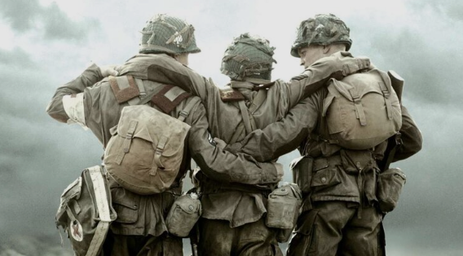
Y6 Autumn Term
World War II

Slide 2
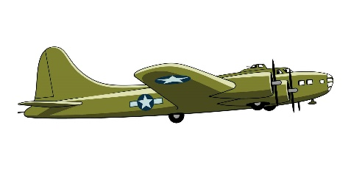
Below is an overview of what we will be learning about this term.
Our Topic
The name of our topic this term is ‘ Their Call of Duty… Their Finest Hour’
For the first half term we will be learning all about the WW2 to answer the our over arching question ‘ How did WW2 impact modern day Britain?’. Then for the second half term, we will move on to our focus on ‘Poland’ during WW2 and focus more heavily on geography.
PE
We ask that children have their full PE kit in school at all times and must take them home to wash at weekends.
Homework
At Thorpe Hesley Primary School we have high expectations with homework and expect it to be handed in on time and to a high standard. In Year 6, this term as we move our focus to SATS, the children will now be given CGP books which focus on SAT style questions. Our expectation this term are:
Read regularly at home, at least 3 times a week. This can be filled in by children themselves but we would encourage adults at home to make a comment at least once a week
Have weekly spellings on a Friday to be completed for the following Friday.
Pupils will be set weekly homework which will alternate between Maths and English. This will be marked with their teacher on a Friday.
All children also have their own log-ins for TT Rockstars which is a great resource for practising times tables.
Thank you for your continued support,
The Year 6 Team x
Science | This term, the children will be learning all about Electricity and light. We will be having fun exploring circuits and looking at how we could use these within our DT work.
History | For our focus this term, We will be focusing on our over arching question ‘How did WW2 impact modern day Britain’. They will learn about the cause of WW2, What is was like living in Britain during WW2 and learn about some of the turning points in WW2 and the consequences and benefits of this.
Geography | During the autumn term, We will move our topic focus on to ‘Poland’. From this, we will be looking at identifying allies and axis across the world during WW2. In addition, we will be looking at local geography to see how our local area was impacted during WW2.
Art/ DT | In Art, we will be experimenting a range of different materials to create different tones, textures and effects. Then the children will be learning to draw using a one-point perspectives. By the end of the topic, the children will be creating their own perspective piece that is based on a London street during WW2. In DT, the children will be researching, designing and making their own Anderson Shelters.
ICT | Children will be developing their word processing skills and PowerPoint, learning how to use the different features of Microsoft office through writing emails and creating posters. The children will then use these skills to create a poster or presentation all about WW2.
PE | Over this term the children will be focusing on football and gymnastics followed by tennis and invasion games in Autum2.
Music | We are very excited to be starting a new scheme for Music and we will exploring a different musician every month!
Spanish | In Spanish, we will be recapping our learning from Year 5 followed by exploring the use of ‘ser’ and ‘tenner’ with confidence. We will then be starting to look at telling the time.
RE | Will focus on having a more detailed understanding of the different concepts of several religious and non religious views and beliefs from around the world.
PSHCE | We will be focusing on challenge and thinking about how we might come across different challenges in our life time.

